Slide 1
Black History Music
Andrew Brown

Slide 2
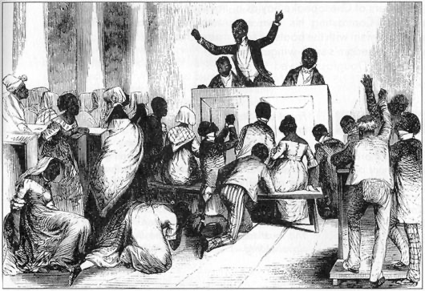
History
Notes:
Hymn-lining - also called lining-out, raising a hymn or precenting a line - is unaccompanied sacred singing in which a leader chants a line and the congregation sings that line in response.

Slide 3
Songs of Freedom
Go Down Moses
Deep Down in My Heart
Jesus Leads Me All the Way
Notes:
A former slave and "conductor" on the Underground Railroad, Tubman said that she used spirituals such as "Go Down Moses" to signal slaves that she was in the area, and would help any who wanted to escape.

Slide 4
American Spirituals/Hymns

Slide 5
Gospel Music Origins
Thomas Dorsey and Mahalia Jackson

Slide 6
Gospel Continued…
Black Churches thriving independently
Influences of Secular music invented by African Americans, like Rock and Roll, Jazz, Blues, R&B, and eventually HipHop
In the other areas of the world like the Caribbean and countries in Africa, their styles of music became infused with Christian music
Invention of Gospel Choirs and quartet
Notes:
https://www.youtube.com/watch?v=ZoJz2SANTyo
https://www.youtube.com/watch?v=3wX-YWOr8RQ

Slide 7
Bibliography
“African American Gospel : Ritual and Worship : Musical Styles : Articles and Essays : The Library of Congress Celebrates the Songs of America : Digital Collections : Library of Congress.” The Library of Congress, www.loc.gov/collections/songs-of-america/articles-and-essays/musical-styles/ritual-and-worship/african-american-gospel.
“African American Spirituals.” The Library of Congress, www.loc.gov/item/ihas.200197495/.
“African American Spirituals.” The Library of Congress, www.loc.gov/item/ihas.200197495/.
Graham, Sandra Jean. “How African American Spirituals Moved From Cotton Fields to Concert Halls: Essay.” Zócalo Public Square, 30 Oct. 2018, www.zocalopublicsquare.org/2018/10/29/african-american-spirituals-moved-cotton-fields-concert-halls/ideas/essay/.
Graham, Sandra Jean. “How African American Spirituals Moved From Cotton Fields to Concert Halls: Essay.” Zócalo Public Square, 30 Oct. 2018, www.zocalopublicsquare.org/2018/10/29/african-american-spirituals-moved-cotton-fields-concert-halls/ideas/essay/.
“The History of Gospel Music.” GospelChops, 5 Feb. 2020, www.gospelchops.com/the-history-of-gospel-music/.
Music, Ranker. “The Most Beautiful Negro Spiritual Songs.” Ranker, www.ranker.com/list/famous-negro-spiritual-songs/ranker-music.
“Take 6: Jubilee Quartets.” Black Music Scholar, blackmusicscholar.com/quartets/.

